Slide 1
Advancements in Information Retrieval: Enhancing Query Expansion and Ranking with CORAG
CSCE 5200 Information Retrieval and Web Search
Abjal Hussain Shaik, Hari Krishna sai Rachuri, Tharun Ramula
Yuan Li, Ph.D.
Computer Science and Engineering Department

Slide 2
Outline
Abstract (optional)
Introduction
Literature Review Overview
Gaps in Current Research (Motivation)
Proposed Methodology
Expected Outcomes
Timeline/Milestone
Conclusion
References

Slide 3
Abstract
Research Focus: Introduces CORAG, a novel approach to improve academic information retrieval.
Problem: Traditional IR models struggle with query expansion, ranking, and retrieval accuracy.
Solution: Uses hybrid retrieval (BM25 + FAISS) and BERT/T5 for query expansion.
Impact: Enhances search relevance, speed, and ranking efficiency in large academic datasets.

Slide 4
Introduction
Feature Engineering in Information Retrieval:
Feature engineering involves selecting and transforming data attributes to improve retrieval accuracy. It plays a crucial role in refining search results and optimizing ranking models.
Motivation:
Traditional IR models struggle with context understanding, query expansion, and ranking optimization. Enhancing these aspects is vital for efficient academic research and large-scale information access.

Slide 5
Introduction (cont. )
Relevance:
With the exponential growth of digital scholarly content, improving retrieval techniques ensures faster, more relevant, and scalable search systems.
Research Question:
How can hybrid retrieval models (BM25 + FAISS) and dynamic query expansion (BERT/T5) enhance precision, ranking efficiency, and scalability in academic information retrieval?

Slide 6
Literature Review Overview
Paper | Contribution | Relevance
Seismic (SIGIR 2024) | Optimized inverted index for fast retrieval. | Improves query efficiency but lacks reformulation.
Inquire (NeurIPS 2024) | Text-to-image retrieval benchmark. | Highlights semantic search challenges.
AD-DRL (ACM MM 2024) | Multimodal recommendation using disentangled representations. | Improves retrieval robustness but not general IR.
CaseLink (SIGIR 2024) | GNN-based legal case retrieval. | Enhances retrieval but high computational cost.
GenQREnsemble (JIR 2024) | Zero-shot LLM-based query expansion. | Advances IR but lacks domain-specific optimization.

Slide 7
Literature Review Overview (cont. )
Trends in Information Retrieval
Hybrid Retrieval: Combining keyword-based (BM25) and vector-based (FAISS) for better ranking.
Query Expansion: LLMs (BERT/T5) improve search relevance. Semantic
Search: Embedding-based models enhance contextual understanding.
Scalability Challenges: Large-scale datasets require efficient indexing methods.

Slide 8
Gaps in Current Research
Gaps: No dynamic query expansion, high retrieval latency, weak semantic understanding, poor domain adaptability.
Query Expansion: BERT/T5 enhances search relevance.
Hybrid Retrieval: BM25 + FAISS improves accuracy and efficiency.
Optimization: Semantic reranking + hierarchical indexing boost speed.

Slide 9
Proposed Methodology
Dataset: ArXiv Research Papers (titles, abstracts, full-text PDFs) for academic search evaluation.
Retrieval Techniques: Hybrid approach using BM25 (keyword-based) + FAISS (vector-based) with BERT/T5 query expansion.
Evaluation: MAP, NDCG, and Precision-Recall to measure accuracy, ranking efficiency, and retrieval speed.

Slide 10
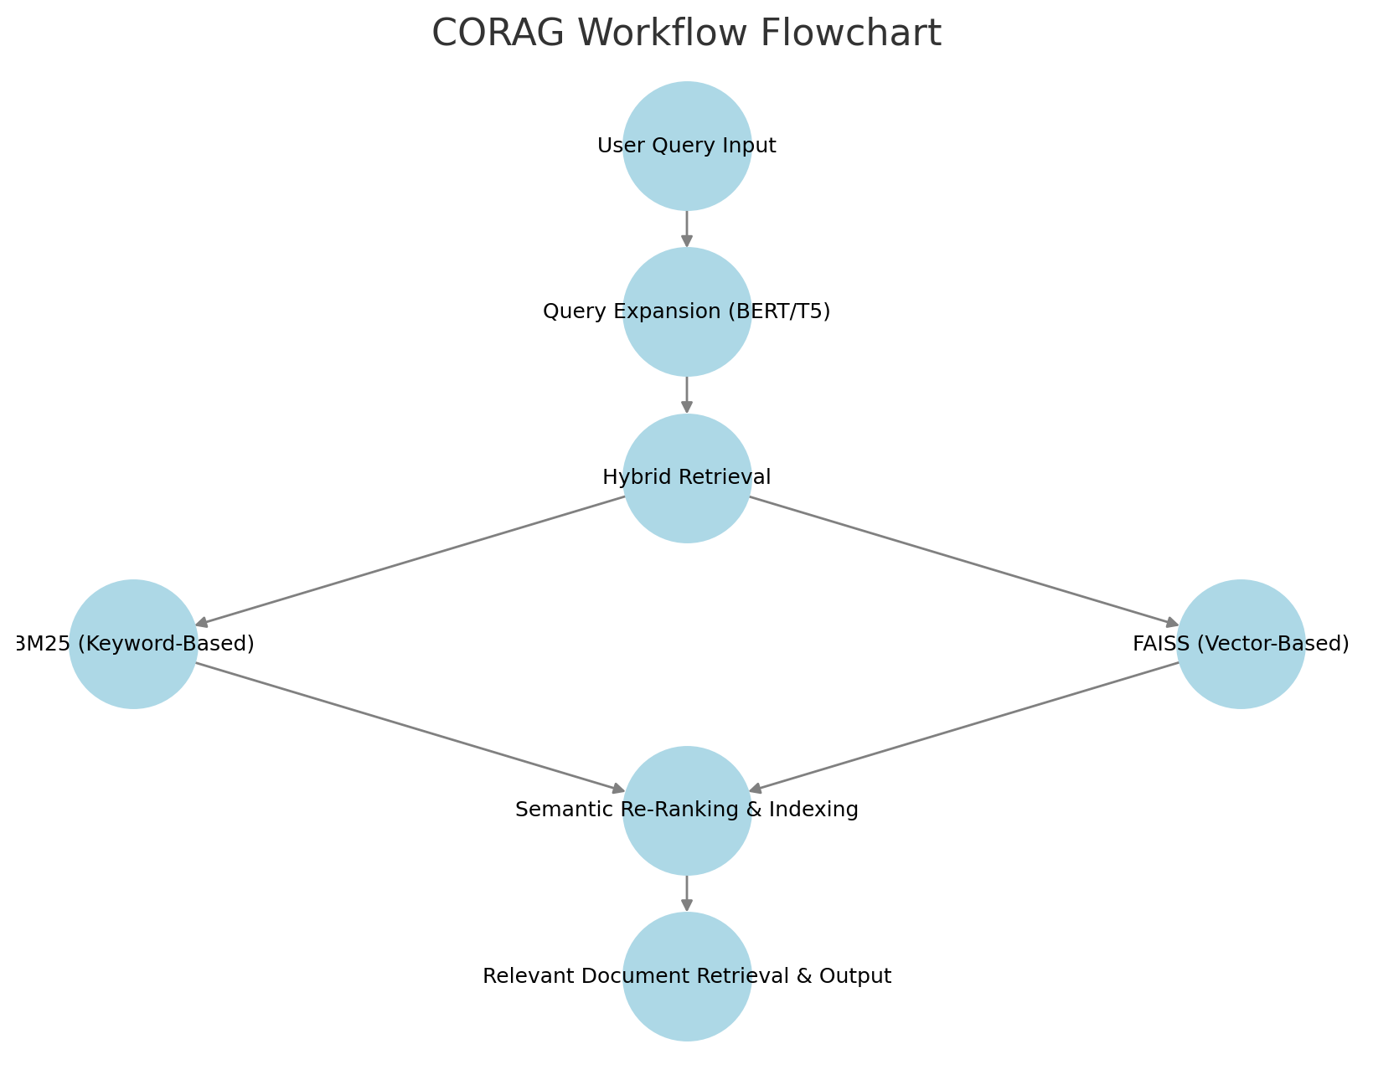
Proposed Methodology (cont. )

Slide 11
Expected Outcomes
Improved Model Performance
Hybrid retrieval (BM25 + FAISS) + BERT/T5 enhances ranking and relevance.
Better semantic understanding improves query expansion and retrieval accuracy.
Higher Retrieval Accuracy
Increased precision, recall, and NDCG scores validate model effectiveness.
Adaptive query expansion ensures more context-aware search results.

Slide 12
Expected Outcomes (cont. )
Faster & Scalable Search Efficiency
Hierarchical indexing + FAISS-based retrieval reduces search latency.
Enables real-time document retrieval, even for large academic datasets.
Transforming Information Retrieval
Bridges keyword-based and vector-based retrieval, improving search relevance.
Helps researchers access relevant papers faster, enhancing knowledge discovery.

Slide 13
Timeline
Task | Deadline | Description
Literature Review | Week 1-2 | Analyze recent IR techniques, identify gaps.
Dataset Collection & Preprocessing | Week 3 | Acquire ArXiv dataset, clean and format data.
Query Expansion Implementation | Week 4 | Implement BERT/T5 for query refinement.
Hybrid Retrieval Setup | Week 5 | Integrate BM25 (Whoosh) & FAISS for search.
Semantic Re-Ranking & Indexing | Week 6 | Optimize ranking with hierarchical indexing.
Model Evaluation | Week 7-8 | Measure MAP, NDCG, Precision-Recall.
Optimization & Fine-Tuning | Week 9 | Improve latency, retrieval accuracy.
Results Analysis & Validation | Week 10 | Compare performance with baseline models.
Final Report & Presentation | Week 11 | Document findings, prepare presentation.

Slide 14
Conclusion
Key Points Recap: CORAG enhances query expansion, retrieval accuracy, and ranking.
Significance: Improves academic search efficiency using hybrid retrieval + AI models.
Expected Contribution: Bridges gaps in semantic understanding and search scalability.
Call to Action: How can this approach be further optimized for real-world academic IR systems?

Slide 15
References
Bruch, S., et al. (2024). Efficient inverted indexes for approximate retrieval. Proceedings of ACM SIGIR 2024.
Vendrow, E., et al. (2024). INQUIRE: A Natural World Text-to-Image Retrieval Benchmark. arXiv preprint arXiv:2411.02537.
Li, Z., et al. (2024). Attribute-driven Disentangled Representation Learning for Multimodal Recommendation. Proceedings of ACM MM 2024.
Tang, Y., et al. (2024). CaseLink: Inductive Graph Learning for Legal Case Retrieval. Proceedings of ACM SIGIR 2024.
Dhole, K., et al. (2024). GenQREnsemble: Zero-shot LLM Ensemble Prompting for Generative Query Reformulation. Proceedings of ECIR 2024.

